Slide 1
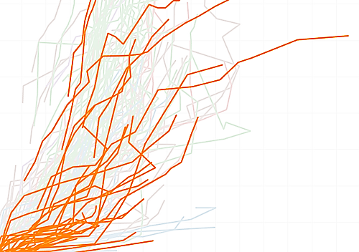
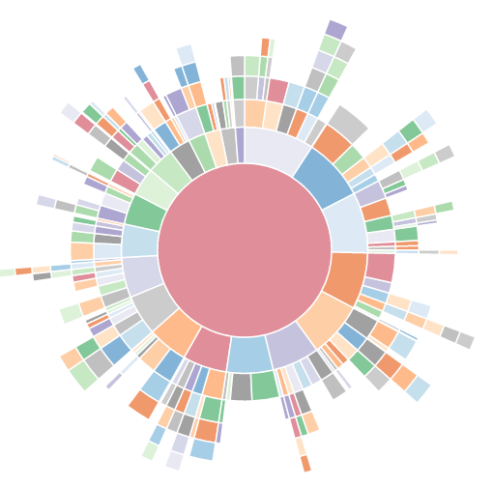
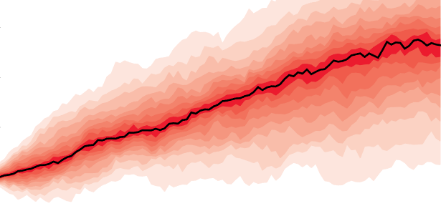
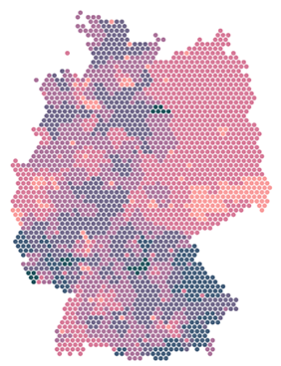
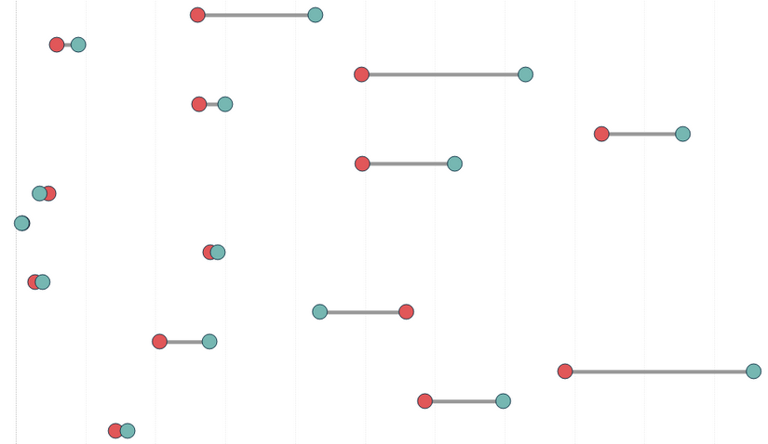
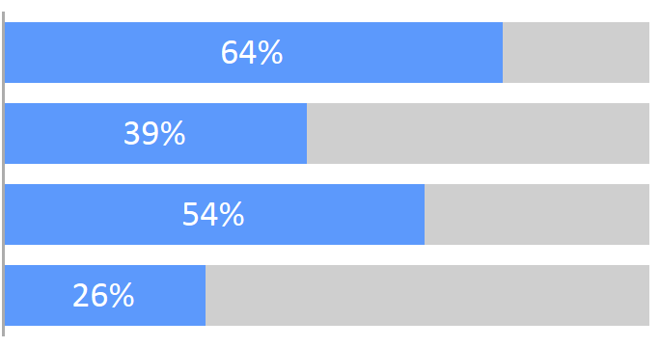
Lesson 8
Visualizations - I
Kush Kulshrestha

Slide 2
“Most of us need to listen to the music to understand how beautiful it is. But often that’s how we present statistics: we just show the notes, we don’t play the music.”
- Hans Rosling
“You can have piles of facts and still fail to resonate. Its not the information itself that is important but the emotional part of that information.”
- Nancy Duarte

Slide 3
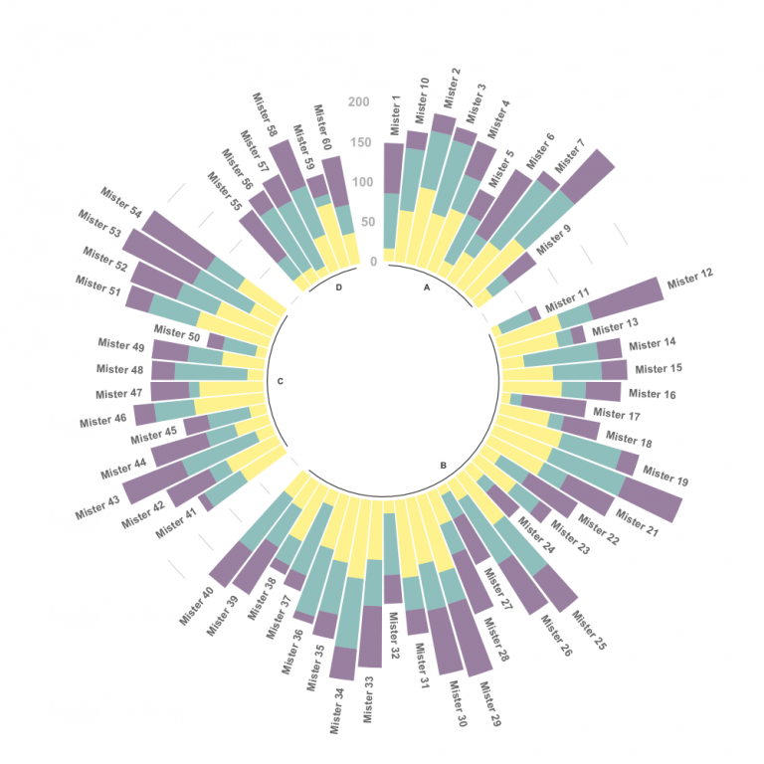
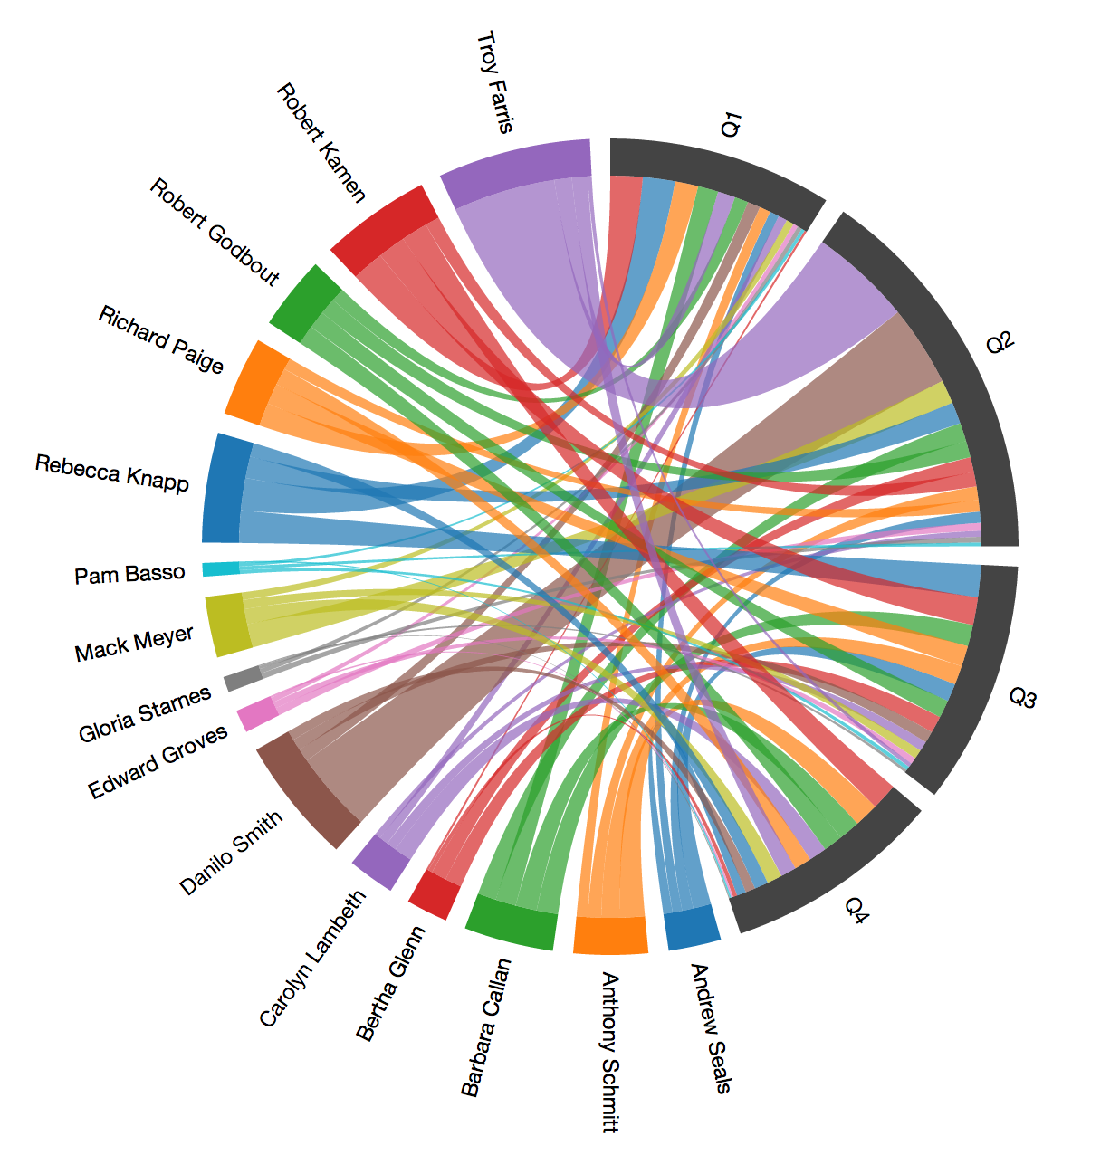
What people think Visualization is…

Slide 4
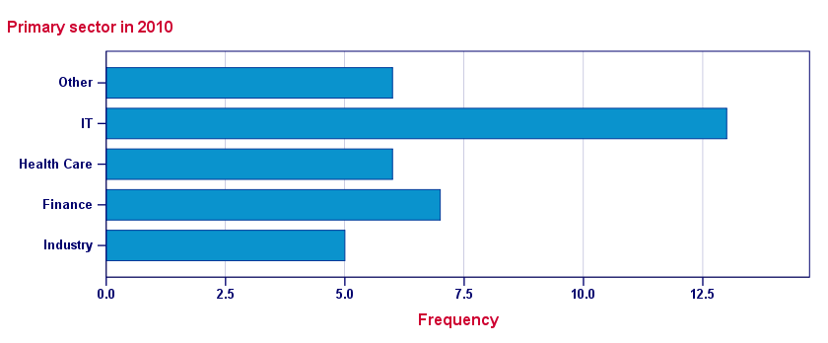
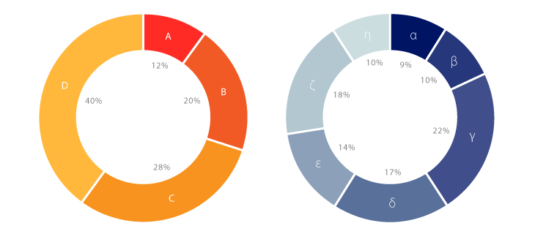
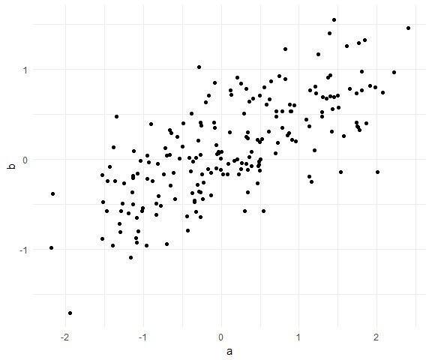
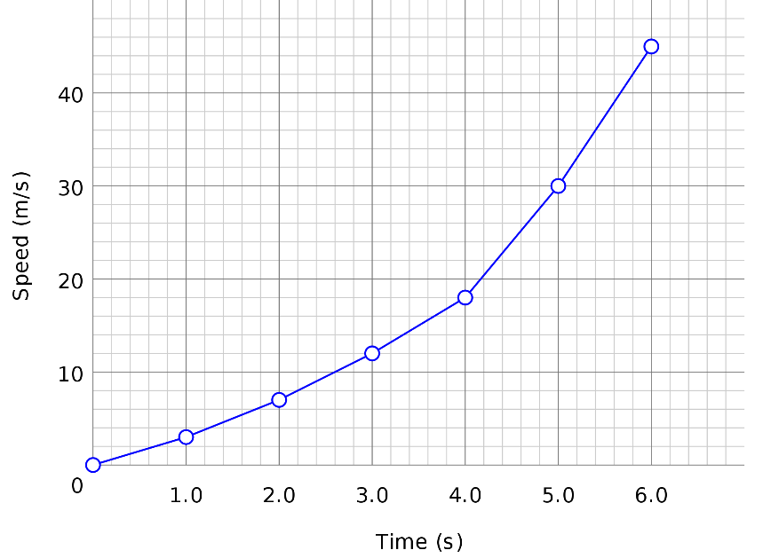
What Visualization is…
+
Some Rules

Slide 5
data visualization
the visual representation of data
a primary goal of data visualization is to communicate information clearly and efficiently to users via the statistical graphics, plots, information graphics, tables, and charts selected
the purpose of visualization is insight, not pictures

Slide 6
Type of Charts
Bar Charts

Slide 7
Bar Charts
- One of the most common ways to visualize data.
- It’s quick to compare information, revealing highs and lows at a glance.
Bar charts are especially effective when you have numerical data that splits nicely into different categories so you can quickly see trends within your data.
When to use bar charts: Comparing data across categories.
Examples: Volume of shirts in different sizes, website traffic by origination site, percent of spending by department.
What types of data can be displayed using a bar chart? - Nominal or Ordinal categories.
- Nominal data are categorised according to descriptive or qualitative information such as county of birth, or subject studied at university.
- Ordinal data are similar but the different categories can also be ranked, for example in a survey people may be asked to say whether they thought something was very poor, poor, fair, good or very good.

Slide 8
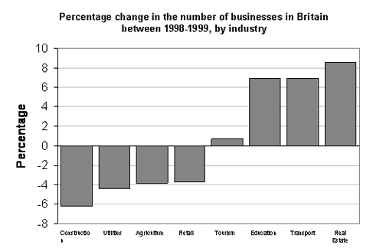
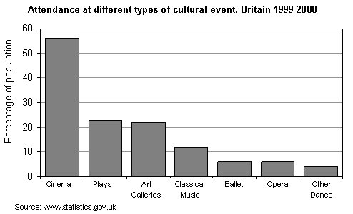
Types of Bar Charts
1) Simple bar charts:
The chart is constructed such that the lengths of the different bars are proportional to the size of the category they represent. The x-axis represents the different categories and so has no scale. In order to emphasise the fact that the categories are discrete, a gap is left between the bars on the x-axis.

Slide 9
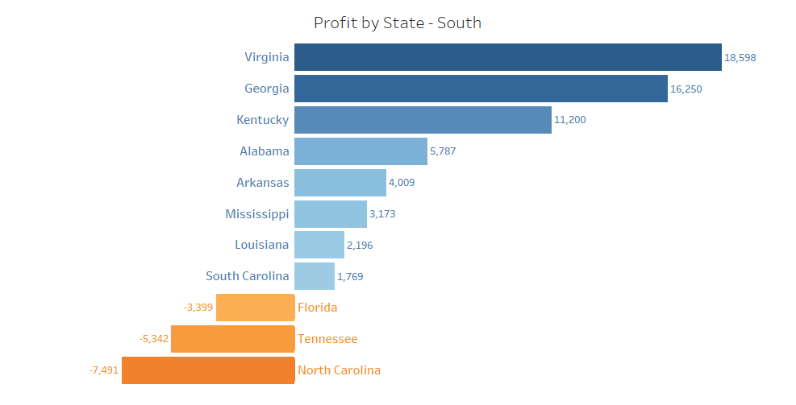
Types of Bar Charts
2) Horizontal bar charts:
The chart is constructed so that the bars are horizontal which means that the longer the bar, the larger the category.
This is a particularly effective way of presenting data when the different categories have long titles that would be difficult to include below a vertical bar, or when there are a large number of different categories and there is insufficient space to fit all the columns required for a vertical bar chart across the page.

Slide 10
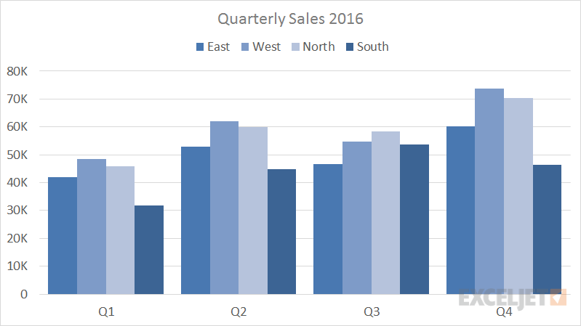
Types of Bar Charts
3) Grouped bar charts:
Grouped bar charts are a way of showing information about different sub-groups of the main categories. A separate bar represents each of the sub-groups (e.g. civic amenity sites) and these are usually coloured or shaded differently to distinguish between them.
But care needs to be taken to ensure that the chart does not contain too much information making it complicated to read and interpret.

Slide 11
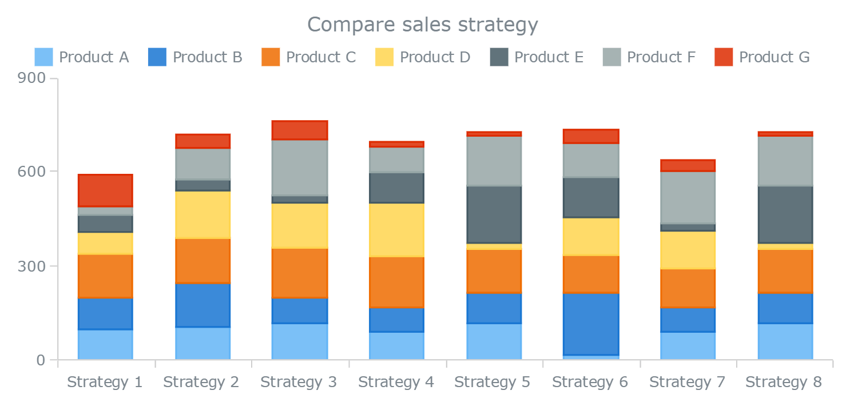
Types of Bar Charts
3) Stacked bar charts:
Stacked bar chars are similar to grouped bar charts in that they are used to display information about the sub-groups that make up the different categories. In stacked bar charts the bars representing the sub-groups are placed on top of each other to make a single column, or side by side to make a single bar.
The overall height or length of the bar shows the total size of the category whilst different colours or shadings are used to indicate the relative contribution of the different sub-groups.

Slide 12
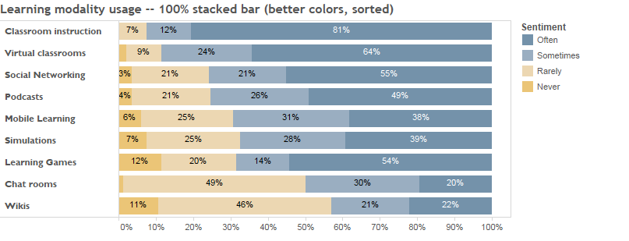
Types of Bar Charts
3) Stacked bar charts:
Stacked bar charts can also be used to show the percentage contribution different sub-groups contribute to each separate category

Slide 13
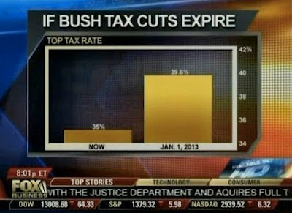
Bar Charts
This is one rule of data visualization that I see broken too often: when it comes to bar charts, the y-axis must begin at zero.
When our eyes interpret bar charts, we are comparing the relative heights of the bars. When we cut the height off at something greater than zero, it skews this visual comparison, over-emphasizing the difference between the bars in a way that simply isn't honest
Beyond the unnecessary visual clutter of tiny gridlines and strange chart borders, the y-axis isn't labeled (I think it's Top Tax Rate, as noted by the subtitle, but this would be a lot clearer if the axis itself were labeled) and it is placed on the right-hand size of the visual, so it's the last thing I see as my eyes scan across from left to right, making it even less likely that I see the biggest issue with the graphic, the fact that the y-axis starts at 34%. This makes the difference between Now (35%) and Jan 1, 2013 (39.6%) appear to be way bigger than it actually is.

Slide 14
Type of Charts
Line Charts

Slide 15
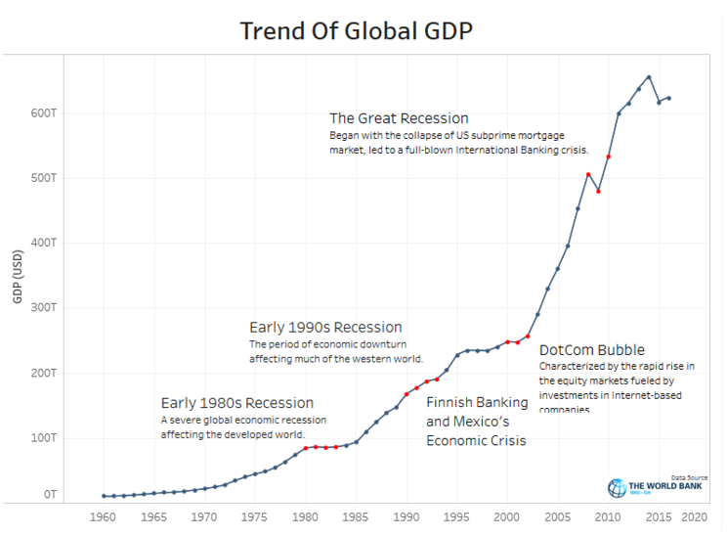
Line Charts
Line charts connect individual numeric data points. Their primary use is to display trends over a period of time.
When to use line charts:
• Viewing trends in data over time. Examples: stock price change over a five year period, website page views during a month, revenue growth by quarter.
Multiple lines can be drawn on the same plot.

Slide 16
Line Charts
S.S. Stevens mentioned, we can consider that line graphs can be used only with those categorical variables that:
1. Have an intrinsic order,
2. The change (difference) between consecutive items makes sense, and
3. All the changes between consecutive items have a similar meaning.
a short list of examples of categories that can or cannot be used with a line chart.
January, February, March (it works, intrinsic order, difference between any two consecutive items is 1 month)
January, February, September (it doesn’t work, intrinsic order is there, yet the difference between February and January is 1 month, but between September and February the difference is 7 months)
Monday, Tuesday, Wednesday (it works, intrinsic order, difference between any two consecutive items is 1 day)
1, 2, 3 (it works)
2, 1, 3 (it doesn’t work, not ordered)
1, 2, 4 (it does not work, order exists, but the difference between consecutive elements is different)
3, 2, 1 (it still works, descending order, the difference between consecutive elements is -1)
Apple, Oranges, Pineapples (doesn’t work, no intrinsic order)
1st Oranges, 2nd Apples, 3rd Pineapples (it works, the rank is actually the categorical variable)
1, 10, 100, 1000 (it works, logarithmic scale, but does not fit into S.S. Stevens' classification)
1, 1/2, 1/3, 1/4 (it also works, fractional scale, but does not fit into S.S. Stevens' classification)

Slide 17
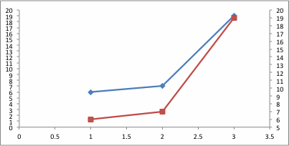
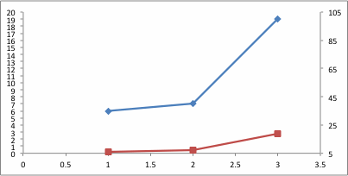
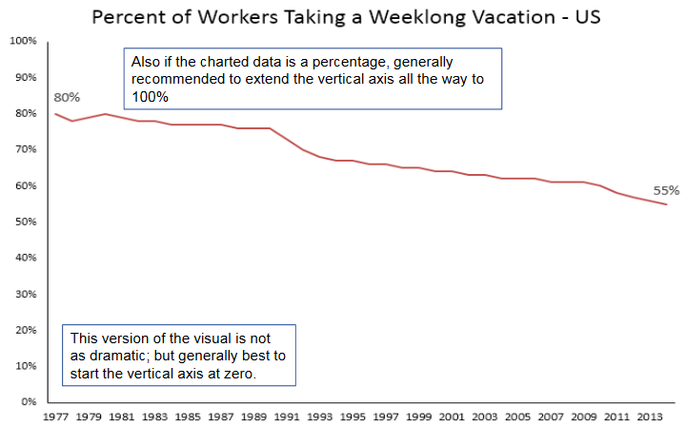
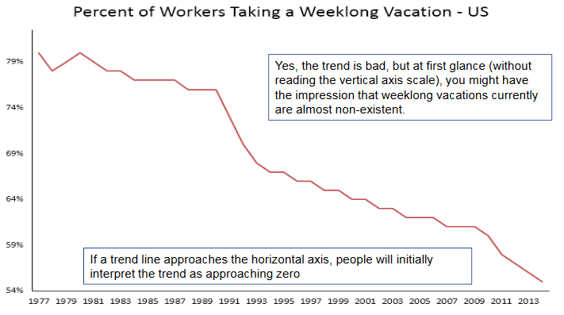
Line Charts
Right baseline
you can get away with a non-zero baseline in a line graph. With line graphs, we compare the lines to each other more than their height from the x-axis.
The first shows the original line (blue) on the primary y-axis (ranging from 0 to 20) and the line rescaled onto a secondary axis (red; with axis ranging from 5 to 20).
The next graph shows the same initial line on the primary axis (blue) and the line rescaled onto a secondary axis (red) that ranges from 5 to 105.

Slide 18
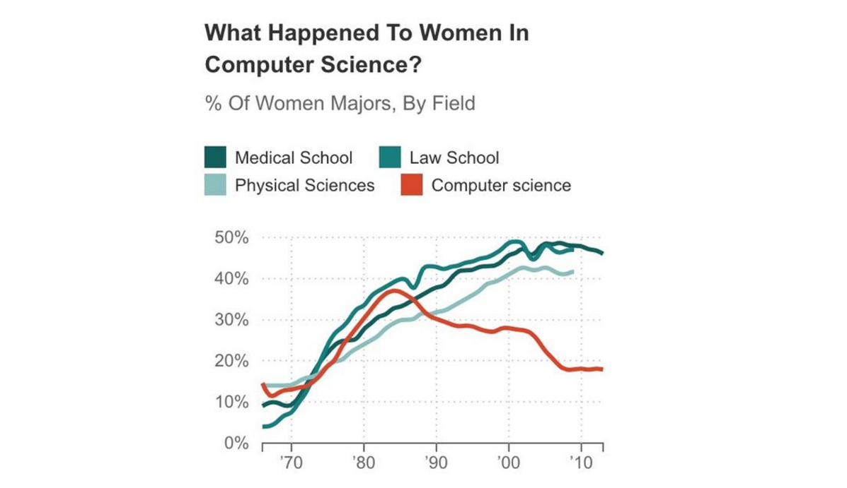
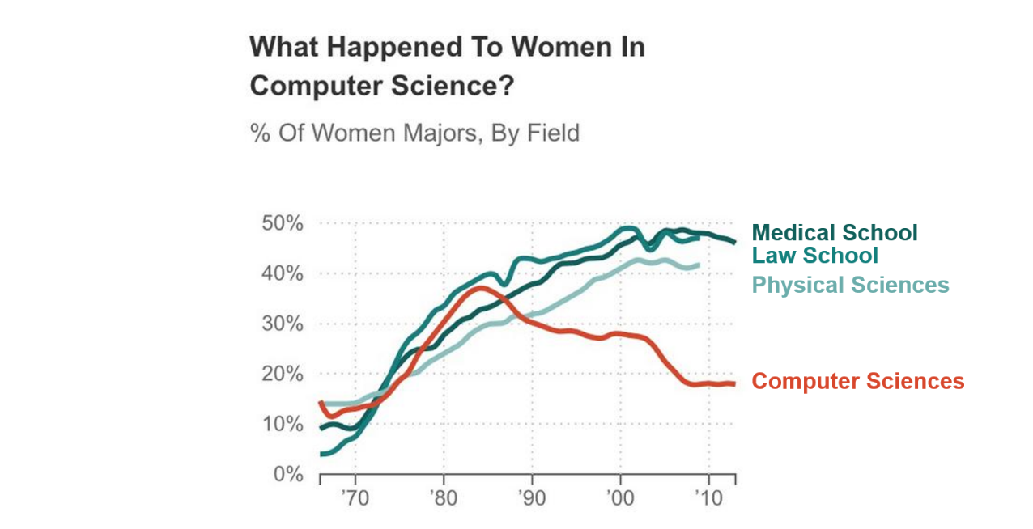
Line Charts
2. Labeling lines directly

Slide 19
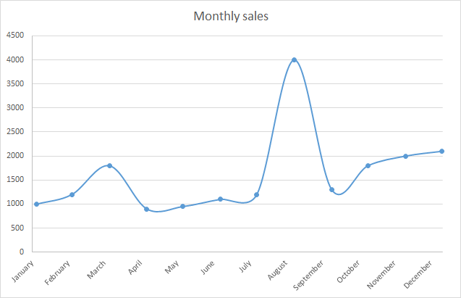
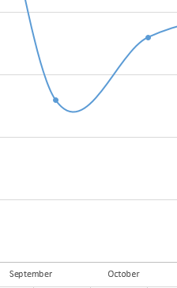
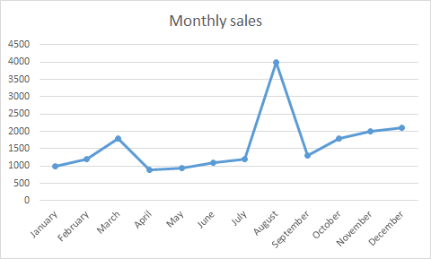
Line Charts
3. Stop lying using the line charts

Slide 20
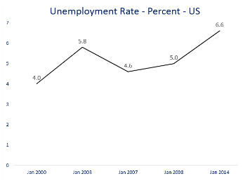
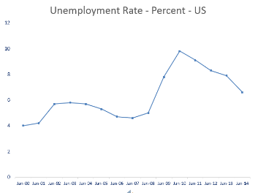
Line Charts
4. Take care of uneven horizontal axis increments.

Slide 21
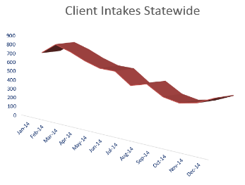
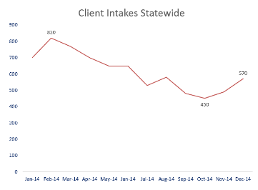
Line Charts
5. No 3D please

Slide 22
Type of Charts
Scatter Plots

